Slide 1

CEIR Grievance Feature -Training Manual

Slide 2

Agenda
Feature Overview
Stakeholder Overview
State Diagram
UI Walk Thru
View All Grievances
View A Grievance
Raise Grievance
Close Grievance
Reply Grievance

Slide 3


Grievance Overview
Grievance Feature allows user to raise their concerns or issue to CEIR admin. The grievance can be raised using this feature
Typical flow is as follows:
User raise a grievance
CEIR admin does one of the following
Reply to the grievance and close the grievance
Reply to the grievance to seek more information
User provide more information
CEIR admin does one of the following
Reply to the grievance and close the grievance
Reply to the grievance to seek more information to reply the grievance
This feature is available for both registered and un-registered users
Importers, Distributor, Retailer, Custom, Manufacturer,
TRC, Operator, End User, Immigration, Lawful Agency
Raise, Reply
CEIR
System
Reply, Close
CEIR Admin

Slide 4
Feature Impact
Importance of this feature for the CEIR System
Raise any concern to CEIR admin
This is kind of customer care feature for stakeholder to reach out to CEIR admin

Slide 5
Stakeholder Overview

Slide 6
State Transition – Overview – Grievance
User
CEIR Admin
New
Close
Raise
Reply by CEIR Admin and Close
Grievance State under various Stakeholder
Reply by CEIR Admin
Reply by CEIR Admin and close
Reply by User
Pendiing
Wth CEIR Admin
Pending With
User
Reply by CEIR Admin

Slide 7
State Transition - Overview
Grievance State | Meaning
New | User has raised a new grievance and is pending with CEIR admin to reply
Pending with User | The CEIR Admin has replied and is pending with user to provide more information on same
Pending with CEIR Admin | The User has provided the information and is pending with CEIR admin to reply
Close | The grievance is closed. It can be closed by system as well if user does not respond within given timelines

Slide 8
UI – Overview - Feature

Slide 9
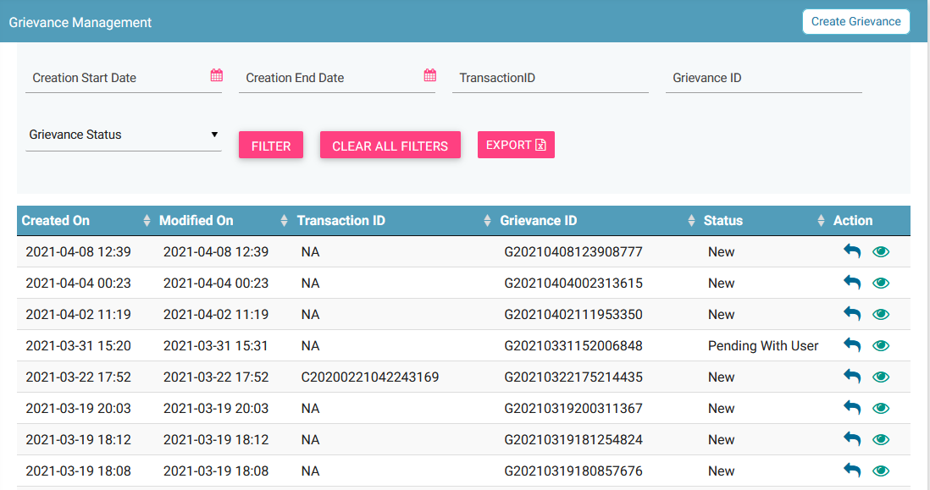
View All Grievance
Report Grievance
Filters
Export
Action like View, Reply
View all grievances

Slide 10
Action List
Action are enabled / disabled based on the state of the grievance.

Slide 11


Actions Enabled/ Disabled for User
S.No. | Grievance Status | Actions Enabled/Disabled
1 | New
2 | Pending With User
3 | Pending with Admin
4 | Close

Slide 12
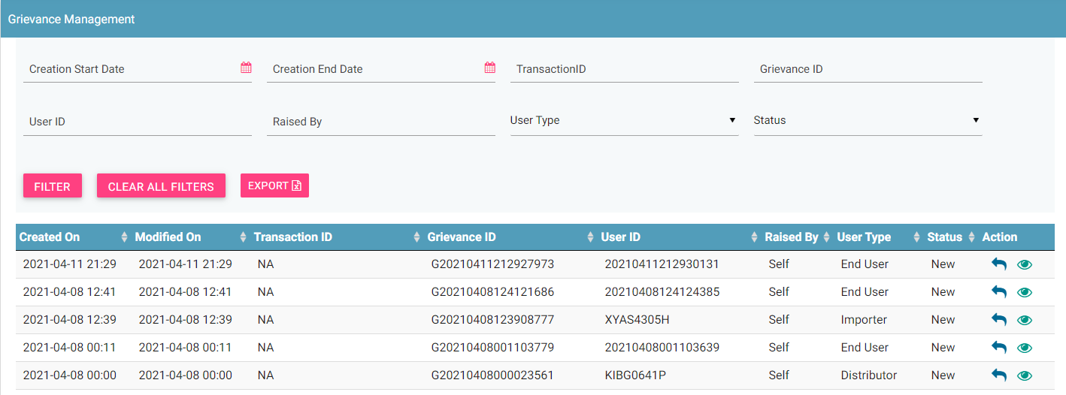
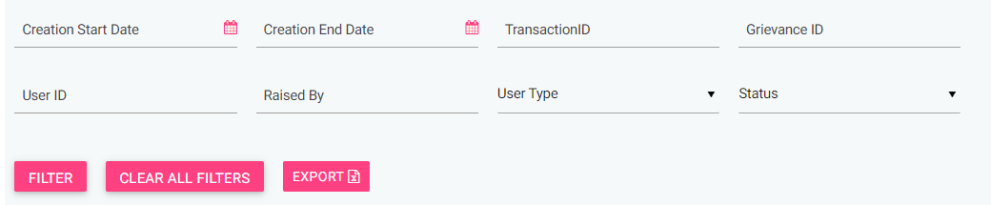
CEIR Admin Portal
By default, grievance with status either as “New” and “Pending with admin” will be displayed in the CEIR Admin queue.
In case CEIR Admin wishes to view grievances in any other state, they can use the filter options to display the same.

Slide 13
Grievance Flow
User raise a grievance
In order to raise a grievance, an Importer needs to furnish the following details:
Transaction id, → Category,
Document Type → Supporting Document,
Remarks
A unique Grievance ID is generated for each new grievance which is raised.
CEIR admin see all the NEW grievance
CEIR admin either does one of the following
Reply to grievance and close grievance.
Need more information from user and hence reply to grievance to see more information. Mail is sent to user and the notification is visible on the dashboard
User see the grievance as “Pending with user”
User update the grievance
User enter the remark and optionally upload documents as required if any
Mail is sent to CEIR admin and the notification is visible on the dashboard

Slide 14
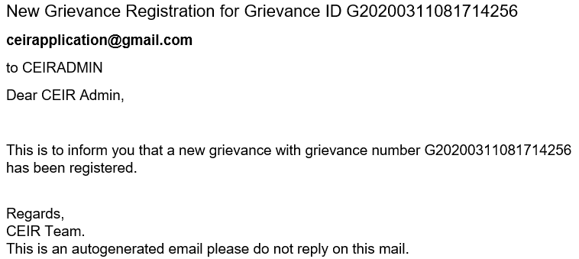
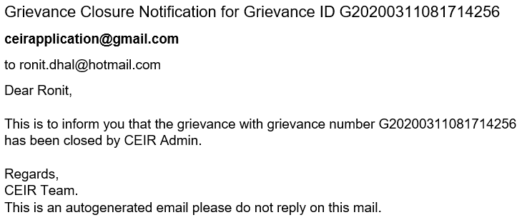
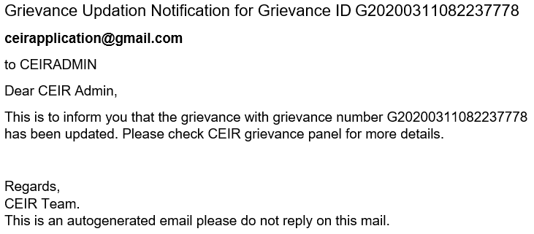
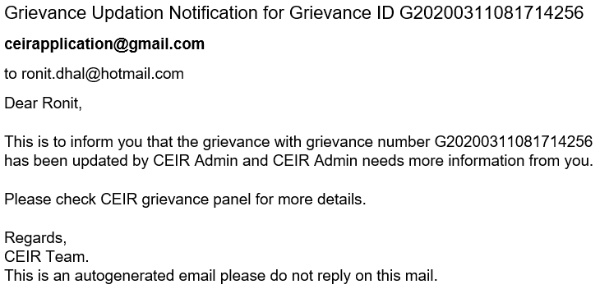
Email samples
Mail on new grievance
Mail when Grievance is closed
Mail when CEIR Admin replies
Mail when user replies
Email contents can be configured from the System Admin portal. This will be explained in detail in the system configuration training.

Slide 15
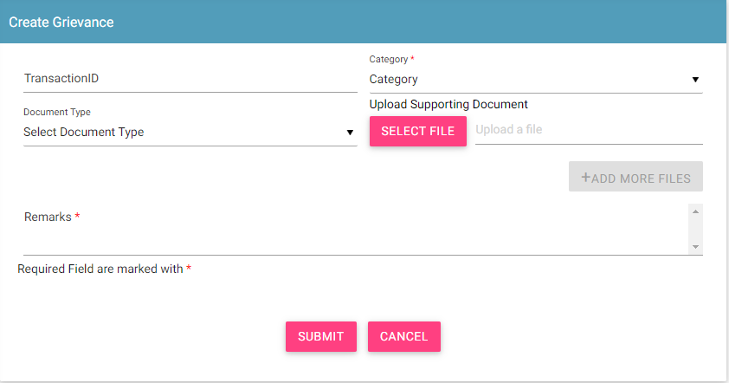
Raise Grievance by Registered User
Some Rules to Follow
Enter Transaction ID when if grievance is related to that feature

Slide 16
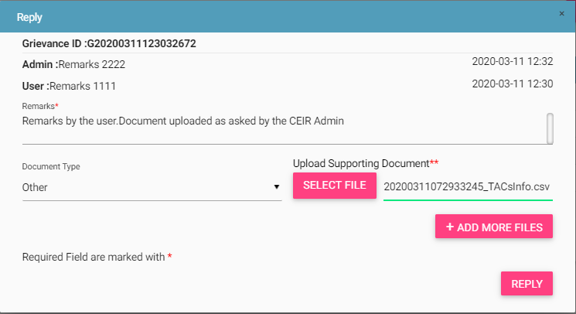
Reply Grievance

Slide 17
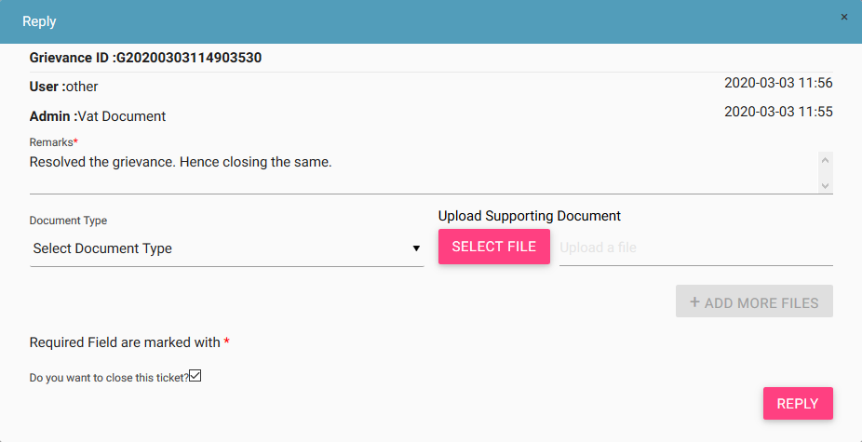
Close Grievance
Who can close the grievance?
CEIR Admin

Slide 18
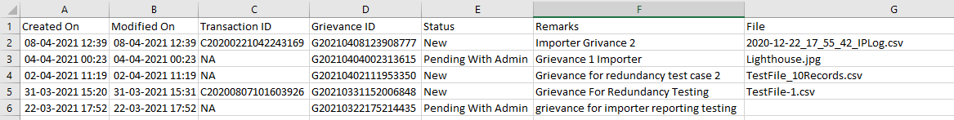
Export Grievance
User can be any one of Importer, Distributor, Retailer, Custom, TRC, Manufacturer, Operator, End User, Immigration, Lawful Agency
Grievance can be exported in a .csv file using the export button.
User can export all grievances assigned to the respective user.
User can export filtered grievance .

Slide 19
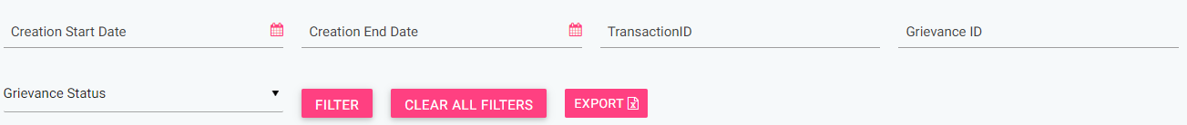
Filter & Sort Grievance
Grievances can be filtered on the basis of
Date filters, Transaction ID, Grievance ID, Grievance Status
The User can also use a combination of more than one filters to filter data.
Users can view old grievances using the date filter.
Clear All Filters can be used to clear filters and refresh the data table.
Export button will export the data based on the filters applied.
By default, the data displayed is sorted in descending order on last modified date.
Data can be sorted based on other fields by clicking the arrow buttons on the column headers. On first click, data will be sorted in ascending order. On second click, it will be sorted in descending order.
User can be any one of Importer, Distributor, Retailer, Custom, TRC, Manufacturer, Operator, End User, Immigration, Lawful Agency

Slide 20
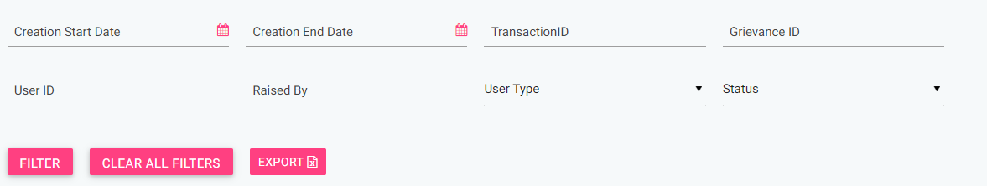
Filter & Sort Grievance ( CEIR Admin)
CEIR Admin can filter grievances on the basis of
Date filters, Transaction ID, Grievance ID, User ID, Raised by, User type, & Grievance Status
The User can also use a combination of more than one filters to filter data.
Users can view old grievances using the date filter.
Clear All Filters can be used to clear filters and refresh the data table.
Export button will export the data based on the filters applied.
By default, the data displayed is sorted in descending order on last modified date.
Data can be sorted based on other fields by clicking the arrow buttons on the column headers. On first click, data will be sorted in ascending order. On second click, it will be sorted in descending order.

Slide 21
Raise Grievance by un-Registered User
Steps to Follow
Go to DMC home page.
Click on Register Grievance – Report Grievance.
Report Grievance page opens up. Fill in the mandatory details and click submit. A new grievance has been raised and sent to CEIR Admin for further action.

Slide 22
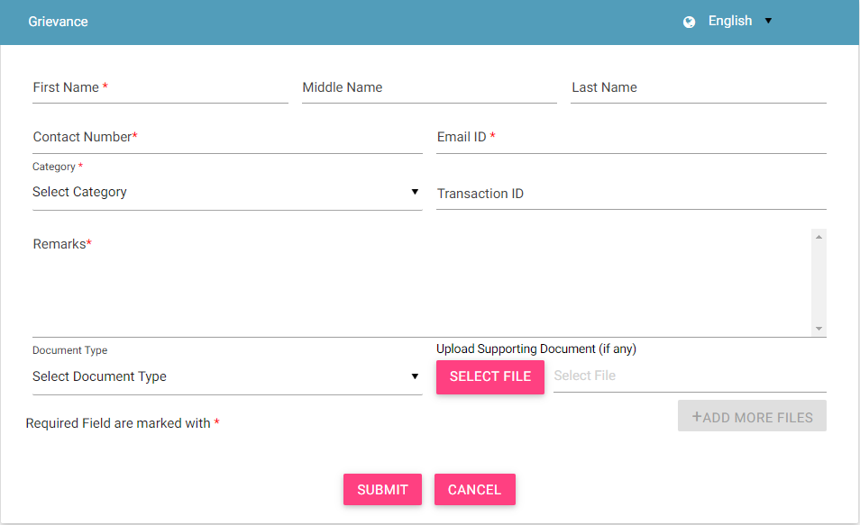
Raise Grievance by un-Registered User

Slide 23
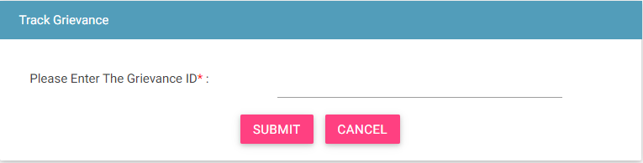
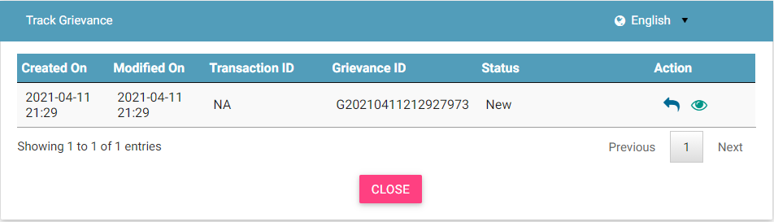
Track Grievance by un-Registered User
Step 1 :
Step 2 :

Slide 24
Queries

Slide 25
Thank You

